Slide 1

THE FUTURE OF COMPUTER-ASSISTED EDUCATION

Slide 2
ITINERARY
What is Computer-Assisted Education
  How does it work?
The rise of online education
Smart Classes
Advantage and Disadvantage
Findings
Analysis
KEY WORDS- Education, Teachers, Smart classes, Videos, Technology.

Slide 3
What is Computer-Assisted Education
Uses technologies and doesn’t require human intervention.
Strategy to make teaching more sustainable.
Provide access to educational resources and opportunities.

Slide 4
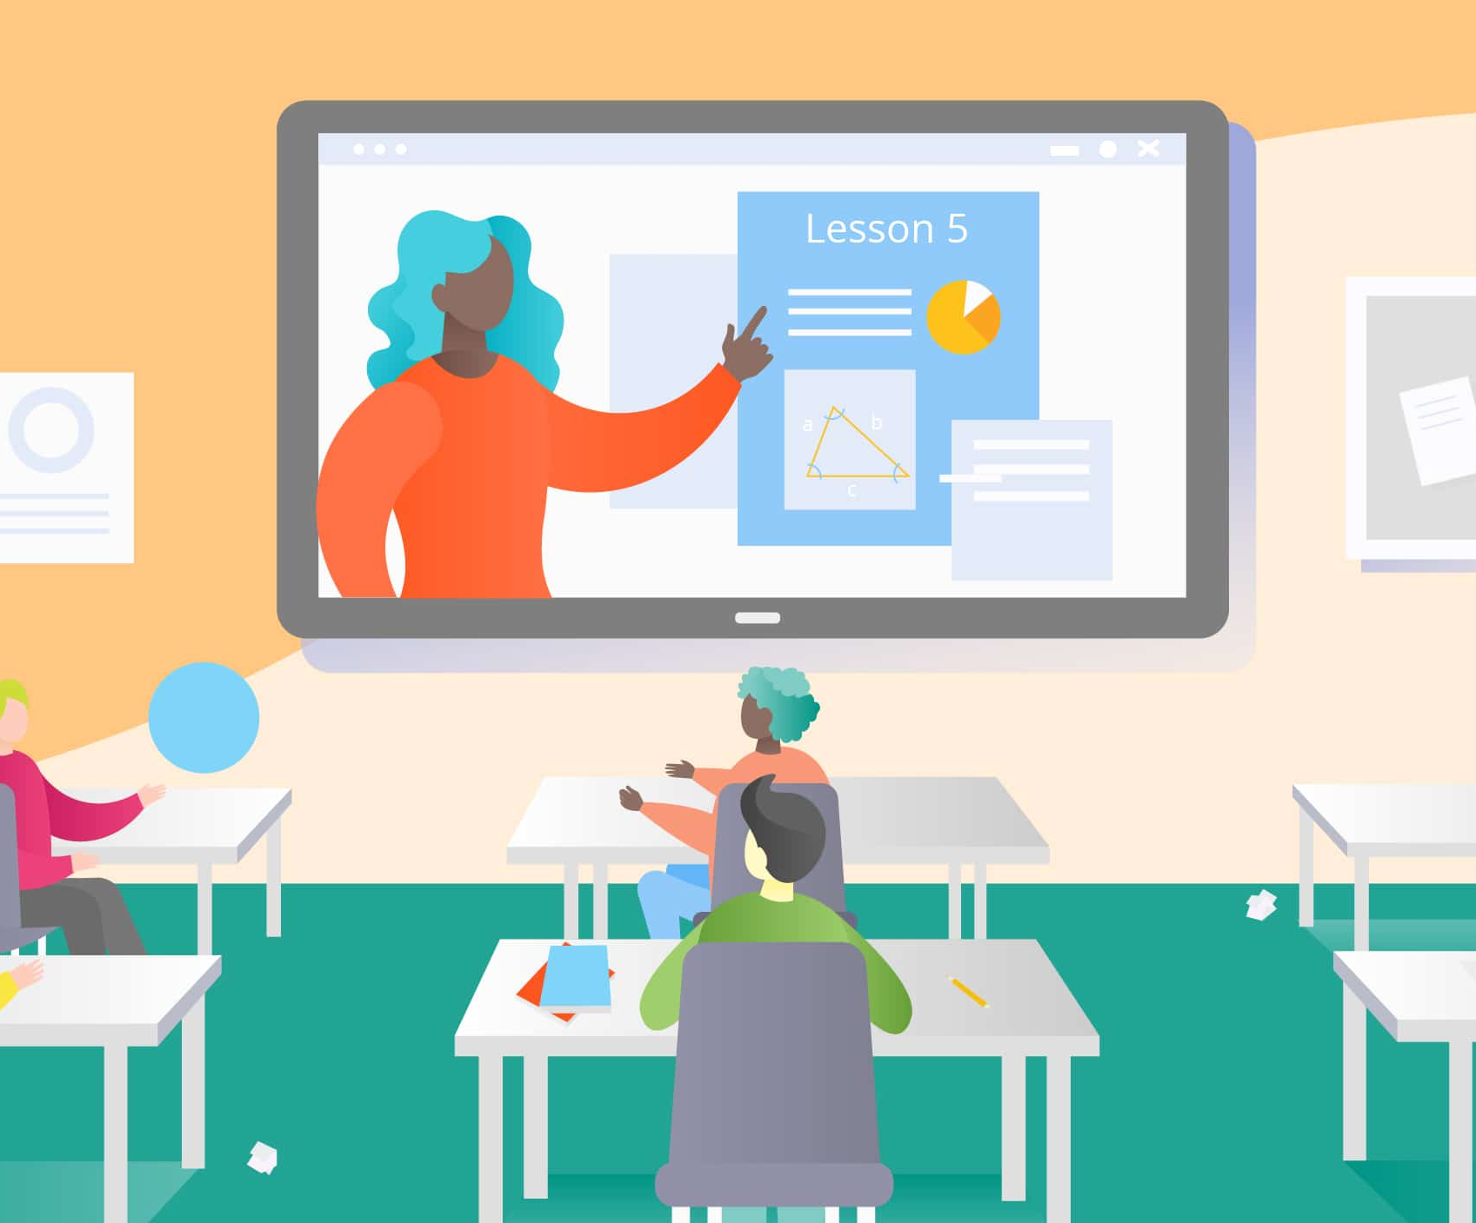
How does It work
Adaptive learning
Collaboration and communication
Feedback and assessment
Access to resources
Delivery of content

Slide 5
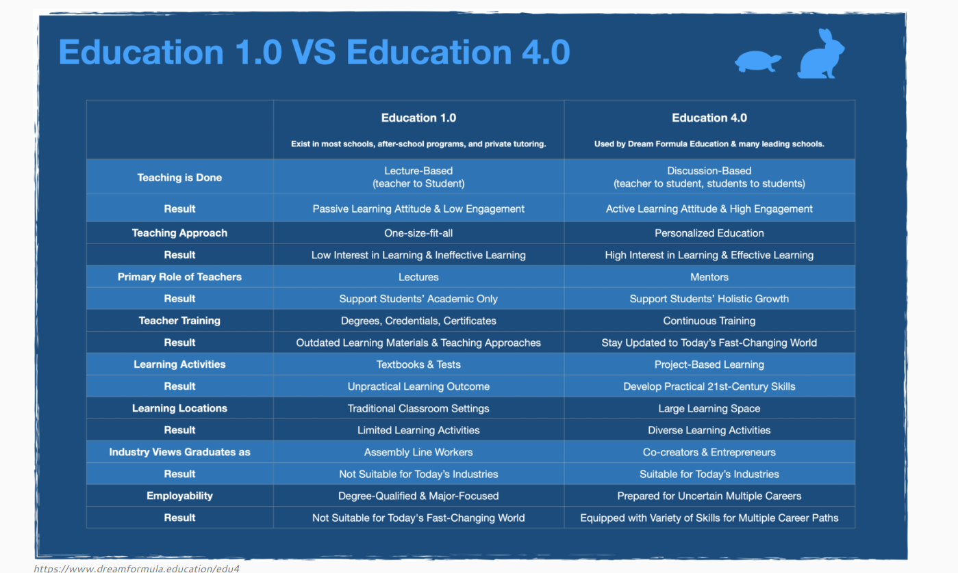

Slide 6
THE RISE OF ONLINE EDUCATION
Online learning has shown significant growth over the last decade.
Since the COVID-19 outbreak, online learning has become more centric in people's lives.
The pandemic has forced schools, and universities to remote working.
Research and Markets forecasts the online education market worth $350 Billion by 2025.
Numerous online learning platforms in the market:
  Udemy
  Coursera
  Lynda

Slide 7
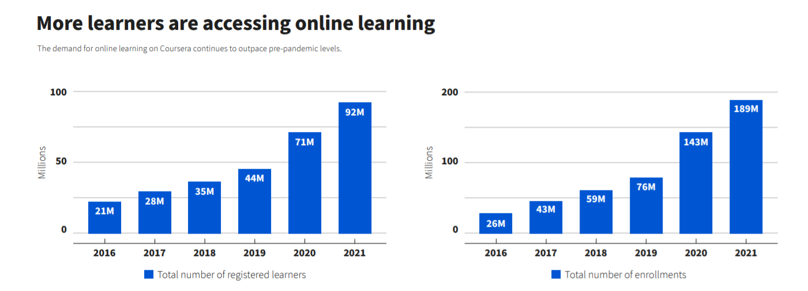

Slide 8
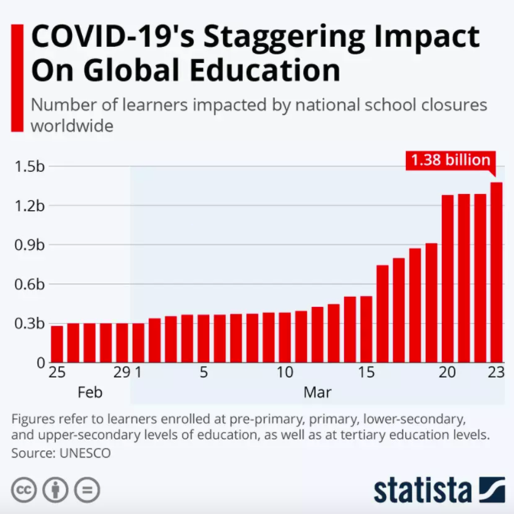

Slide 9


Platform to Bring teams together, reimagine workspaces, engage new audiences.
A platform for bringing students and teachers together.
Helps teachers and students to connect and collaborate together.
A platform made by Google, it helps connect school communities with classes, parent-teacher conferences and more.

Slide 10
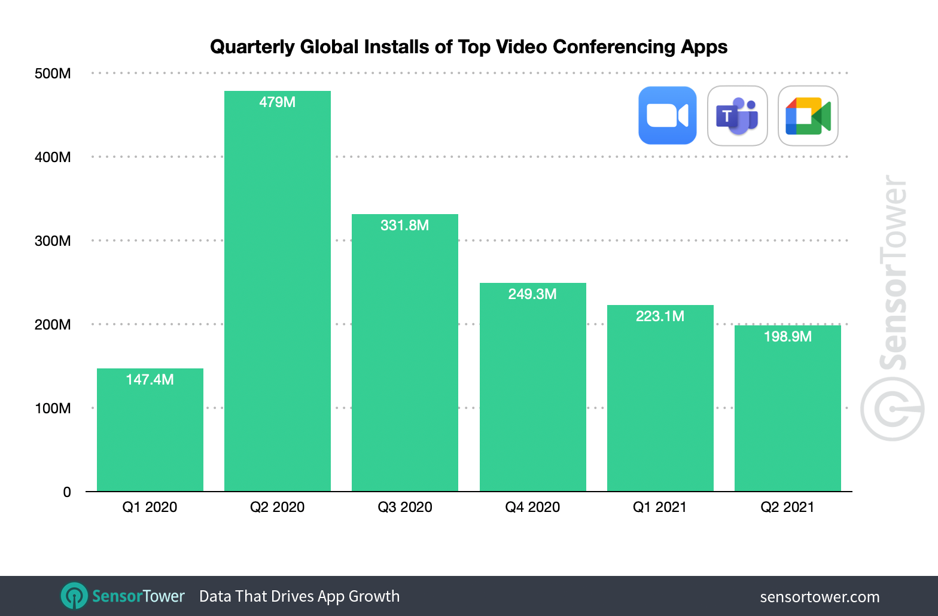

Slide 11
Advantages
Helps the students to see their daily progress
Helps the students understand the complex topic by breaking it down
It is very interesting and students find it engaging
It caters to the individual
Promotes active interaction
Flexible schedule

Slide 12
Disadvantage
Technology can be distracting
Less direct social interaction
It Can Be Expensive
Faster but less memorable learning

Slide 13


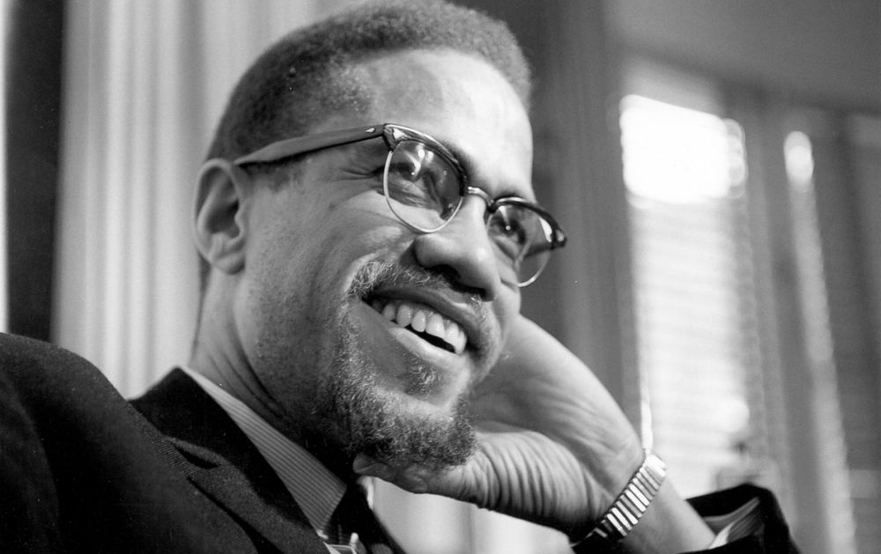
Education is the passport to the future, for tomorrow belongs to those who prepare for it today.
Malcolm X

Slide 14
Findings & Analysis
It has been analyzed that computer assisted education doesn’t mean eliminating teachers.
Computers aren’t restricted to one field of education but are open to all areas of education from science to medical.
Virtual class rooms can be created anywhere any time.
Teaching institutes have adopted new teaching ways such as intelligent boards.
About 86% of educators told that they use laptops in classrooms.

Slide 15


Conclusion
According to our research, computer assisted education is the most efficient method of teaching and is found to be significant as it increases the interest of students and enhances their motivation level.

